Slide 1

Hospital Management System

Slide 2
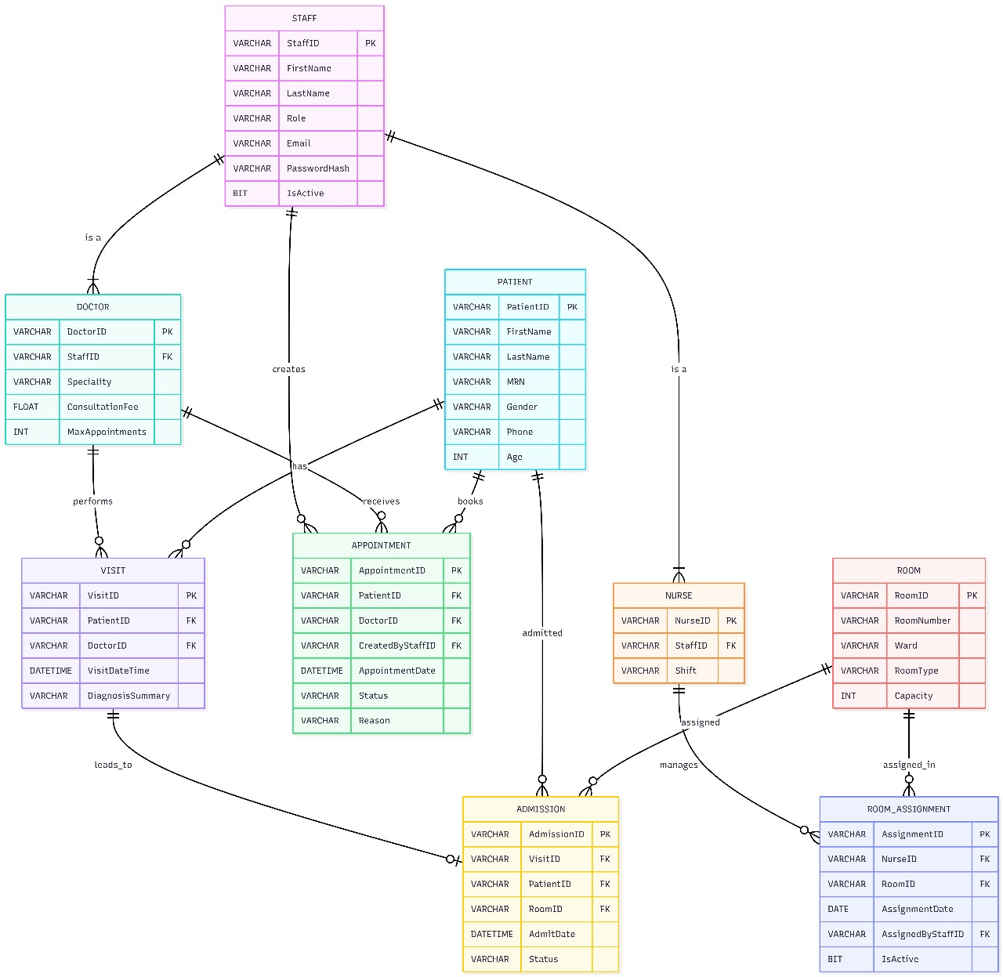

Slide 3

Hospital Management System Vision
Comprehensive Digital Healthcare Solution
The Hospital Management System is designed to transform healthcare operations by integrating modern technology into a comprehensive digital solution, enhancing efficiency across all departments.
Technology Stack
Built on advanced technologies like .NET MAUI, C#, SQL Server, and MVVM Architecture, the system ensures robustness, scalability, and modern user interfaces.
Streamlining Operations
This system streamlines healthcare operations, reducing manual processes and improving the overall workflow, ensuring smoother and more efficient patient care.
Project Proposal
This project proposal for SAZ Hospital in 2025 aims to modernize healthcare delivery through intelligent automation and intuitive design, setting a new standard in digital healthcare.

Slide 4
Executive Summary
Modernizing Healthcare Operations
The Hospital Management System is a comprehensive digital solution designed to modernize and streamline healthcare operations across multiple departments, including reception, medical staff, and administrative personnel.
Key Features
Centralized patient record management and appointment scheduling, role-based access control for different staff roles, real-time room assignment, and integrated visit management with admission workflows are core features.
Security and Data Protection
The system ensures secure authentication and robust data protection mechanisms, safeguarding patient information and maintaining compliance with healthcare standards.

Slide 5

Current Challenges in Healthcare
Manual Processes
Manual paper-based appointment scheduling causes delays and errors, while inefficient room assignment leads to resource underutilization, impacting overall operational efficiency.
Fragmented Information
Fragmented patient information across multiple systems, lack of real-time visibility into staff workload, and time-consuming manual processes for visit documentation hinder coordinated care.

Slide 6
Layered Architecture Blueprint
01
02
03
04
Presentation Layer
ViewModel Layer
Service Layer
Database Layer
The Presentation Layer, built with XAML and Code-Behind, provides intuitive user interfaces for doctors, nurses, and receptionists, ensuring real-time updates and seamless navigation.
The ViewModel Layer implements business logic using the MVVM pattern, leveraging ObservableObject, RelayCommand, and data binding through CommunityToolkit.Mvvm for responsive and maintainable code.
The Service Layer includes services for appointments, patients, doctors, nurses, and room assignments, encapsulating business operations and ensuring efficient data handling.
The Database Layer, powered by SQL Server, provides a robust relational database with tables for patients, staff, appointments, room assignments, and admissions, ensuring data integrity and performance.

Slide 7

Role-Based Workflow Matrix
Receptionist Responsibilities
Receptionists handle patient registration, appointment scheduling, room assignment to nurses, and managing appointments, ensuring smooth front-end operations.
Doctor Responsibilities
Doctors view daily appointments, create comprehensive visit records, update patient diagnoses, and request admissions, focusing on patient care and documentation.
Nurse Responsibilities
Nurses view assigned rooms, access patient information, check assignment history, and monitor daily workload, ensuring efficient patient care and coordination.

Slide 8

Quantified Benefits & ROI
Modernizing Healthcare
The Hospital Management System modernizes healthcare operations, improving patient care quality and enhancing operational efficiency through intelligent automation and intuitive design.
Expected Benefits
Thank You
Expected benefits include a 50% reduction in appointment scheduling time, improved resource utilization, enhanced patient satisfaction, real-time data access, and reduced administrative overhead.
Thank You for Your Attention! We look forward to transforming healthcare operations and delivering exceptional patient care with the Hospital Management System.

Slide 9
THANK YOU

